Slide 1

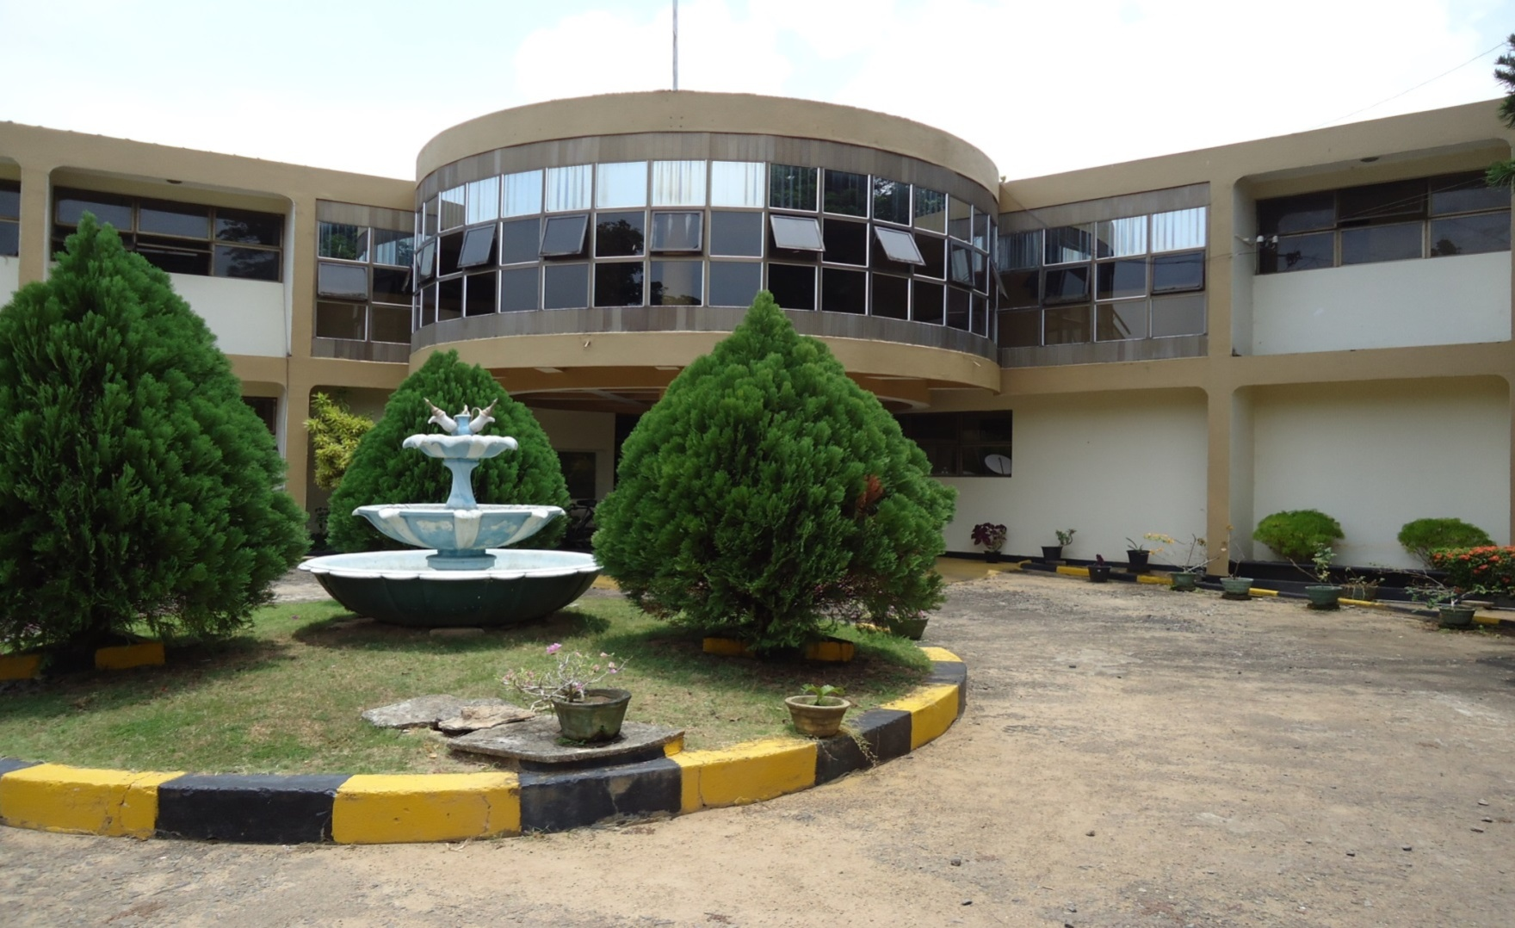
IQRAA TECHNICAL TRAINING INSTITUTE-SRI LANKA
IQRAA CHARITABLE SOCIETY-JEDDAH,SAUDI ARABIA
&
ISLAMIC RENAISSANCE MOVEMENT, SRI LANKA.
Managed by
IQRAA TECHNICAL TRAINING INSTITUTE TRUST

Slide 2
Vision
To be the best Technical Training Institute in Sri Lanka providing training to produce human resources which could contribute towards reduction of poverty, improvement of quality of life and the socio economic development of Sri Lanka.
Mission
To provide employable skills to underprivileged youth and empower them fruitfully.
Objectives
Poverty alleviation among the poorest segment of the community through finding job opportunities locally and internationally.
To liaise with international and national organizations to upgrade training facilities and methods.
To offer qualified craftsmen to the various industries who contribute to the economy.

Slide 3
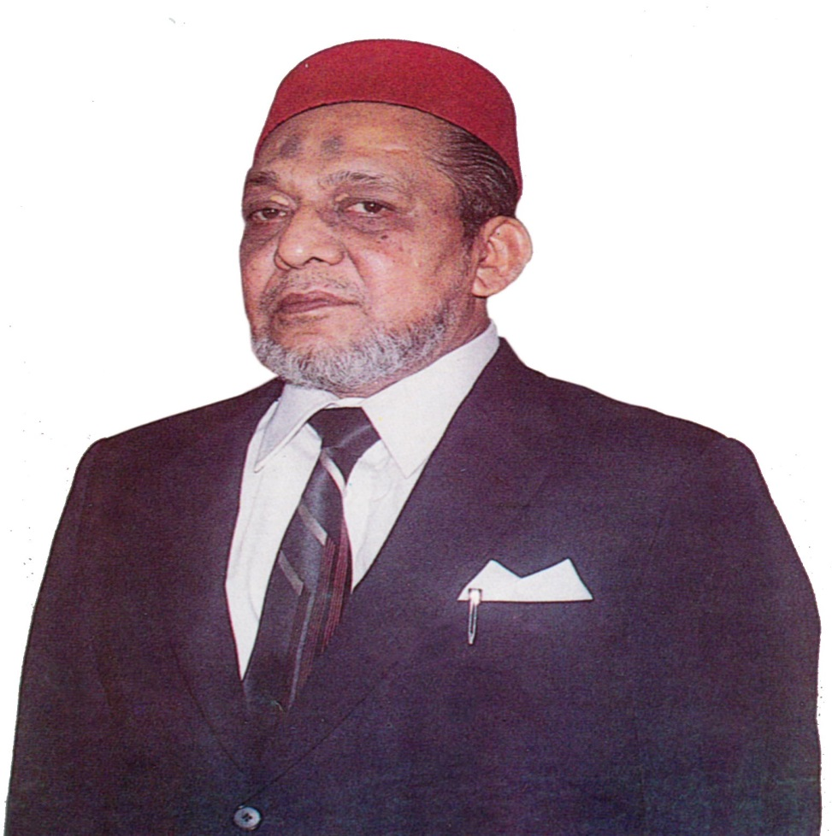
Naleem Hajiar (Rah)
Founder of
Jamiah Naleemiah
&
Iqraa Technical Training Institute

Slide 4
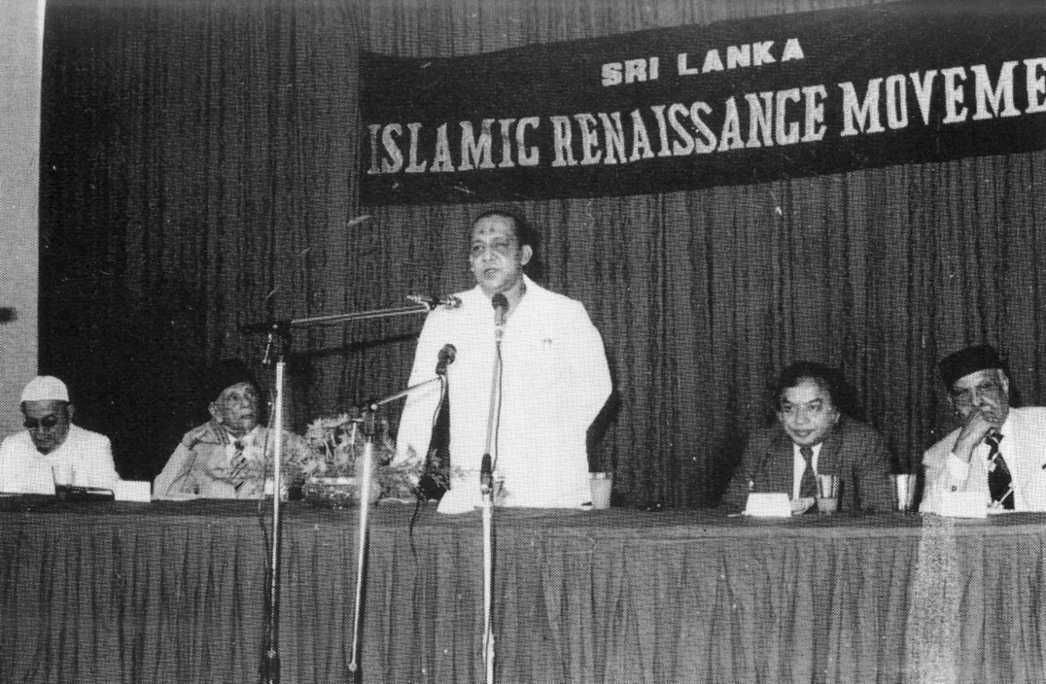
Naleem Hajiar (Rah) declaring the decision of Sri Lanka Islamic Renaissance Movement to establish a Technical Training Institute. In the presence of Ministers M.H.Mohamed, A.C.S.Hameed , Former Minister Dr.Badiuddin Mahmood , Sir Razick Fareed and others on 22nd February 1982

Slide 5
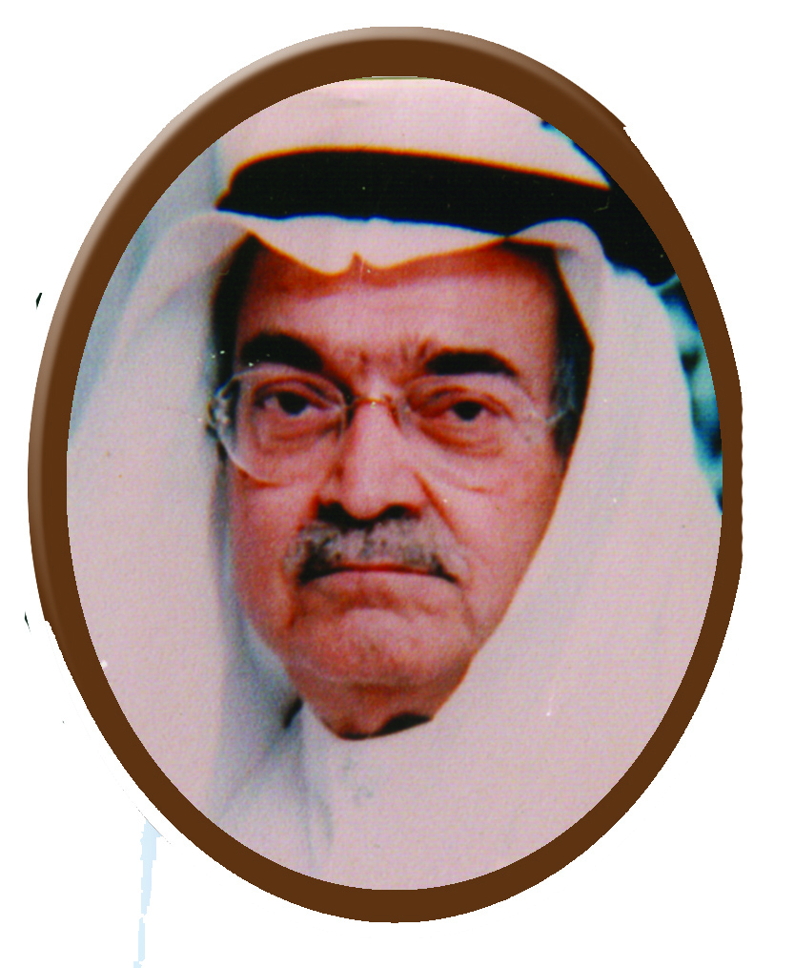
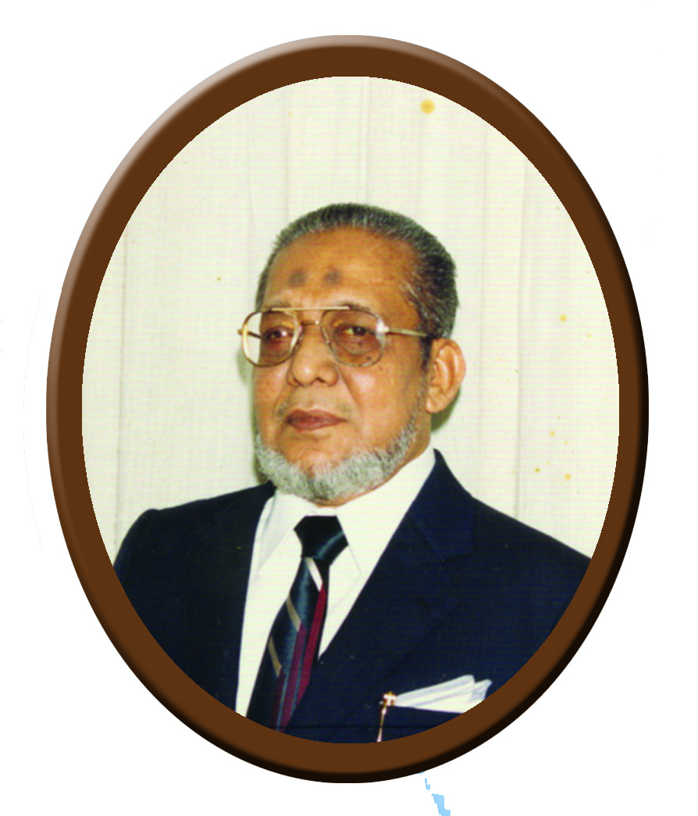
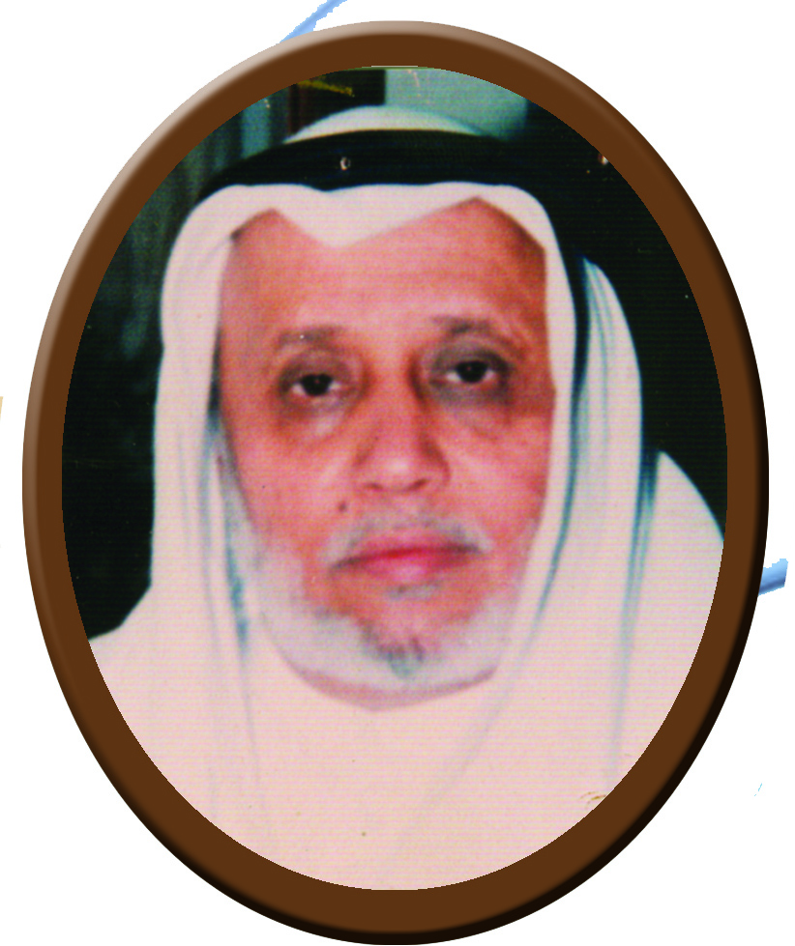
Founders
Sheikh Saleh Kamel Naleem Hajiar (Rah) Dr.Muhammed
Abdo Yamani (Rah)

Slide 6
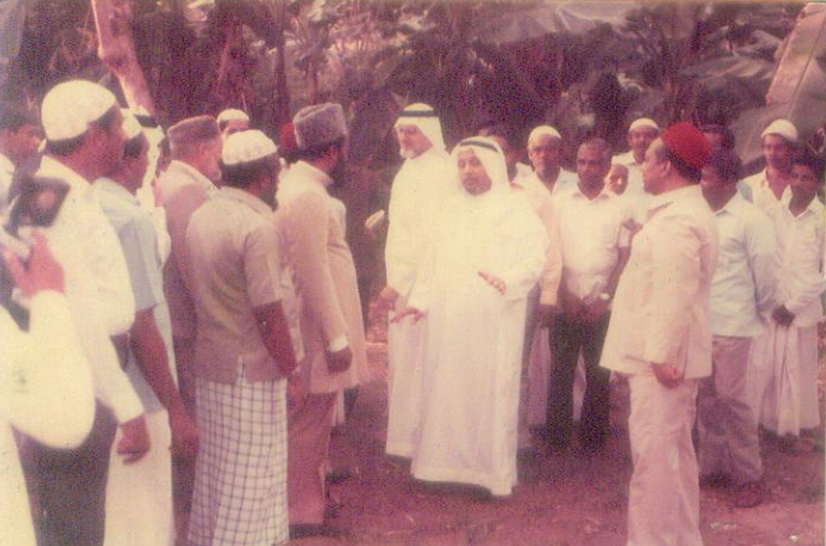
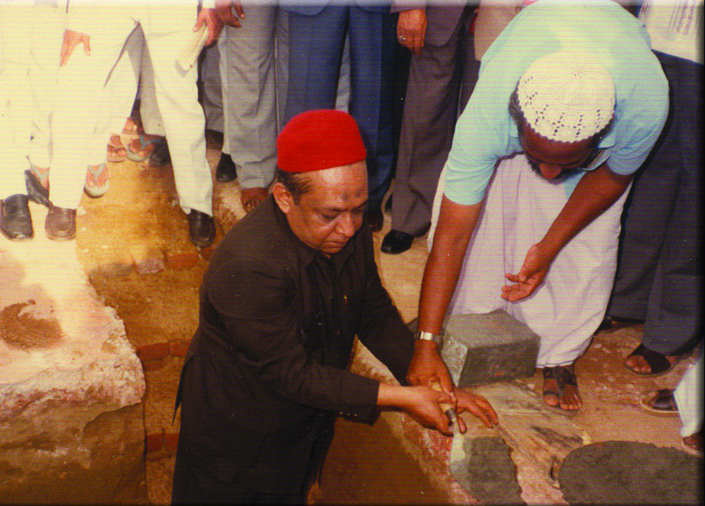
Foundation Stone Laying by Naleem Hajiar (Rah) on 7th July 1985
Dr. Muhammed Abdo Yamani (Rah) & Dr. Abdullah Omar Naseef, Secretary General of Rabithathul Alam Al-Islami inspecting the site for IQRAA T.T.I.
on 6th March 1985

Slide 7
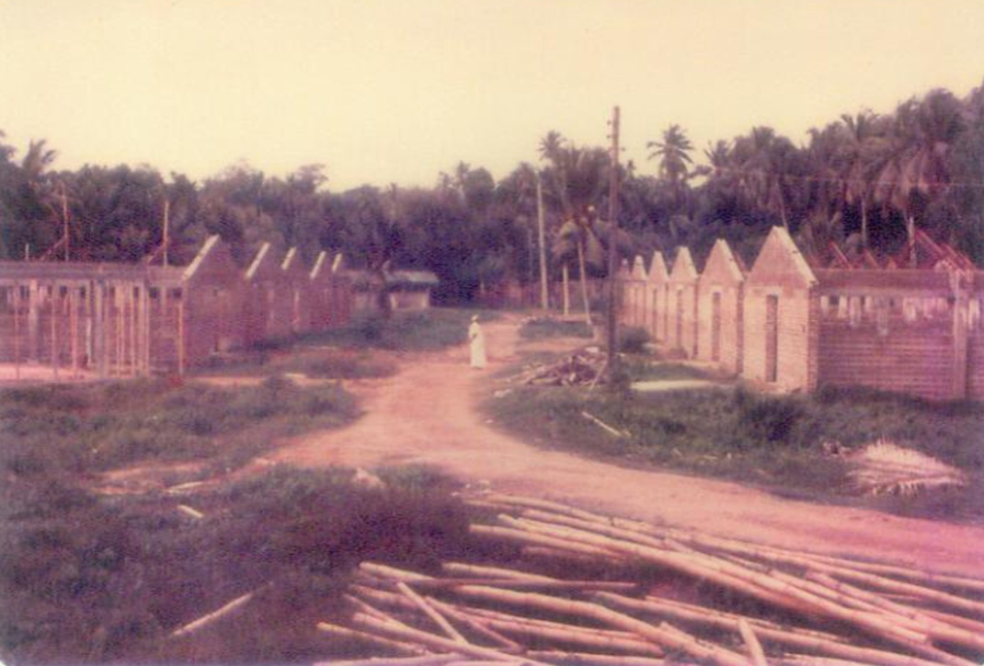
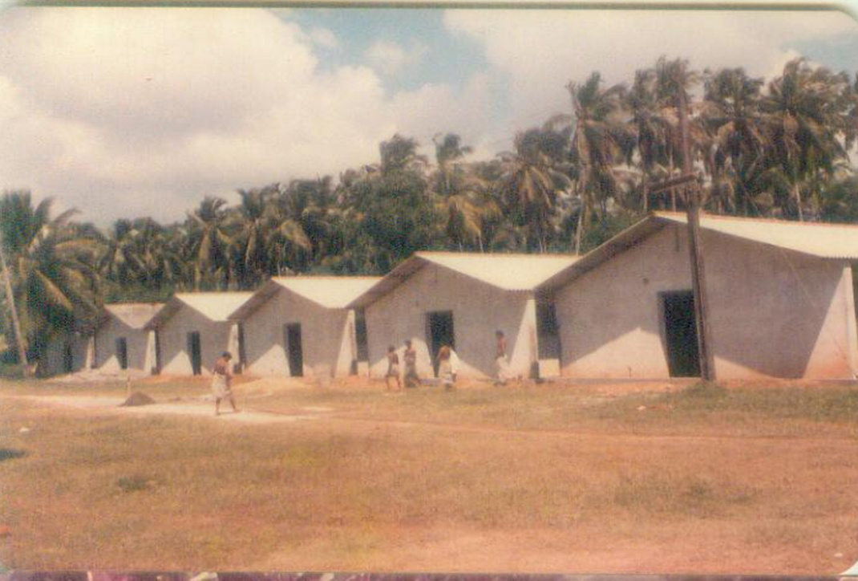
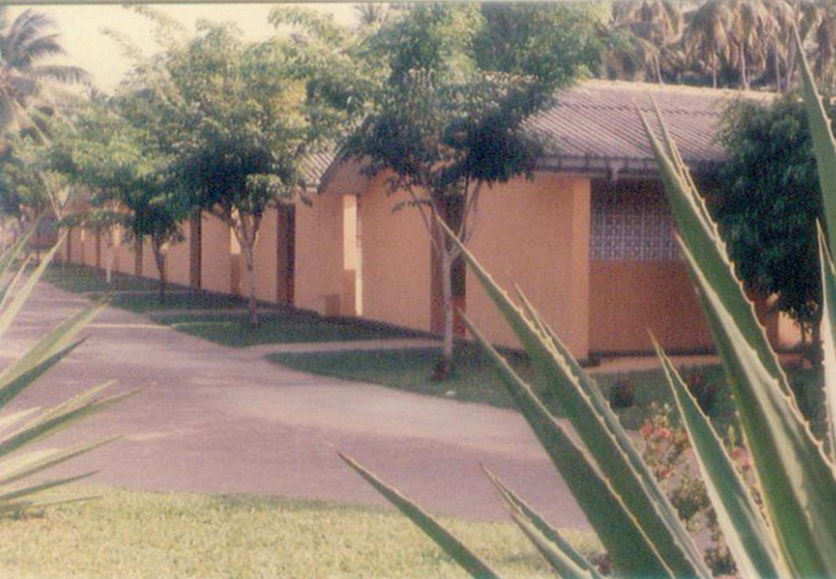
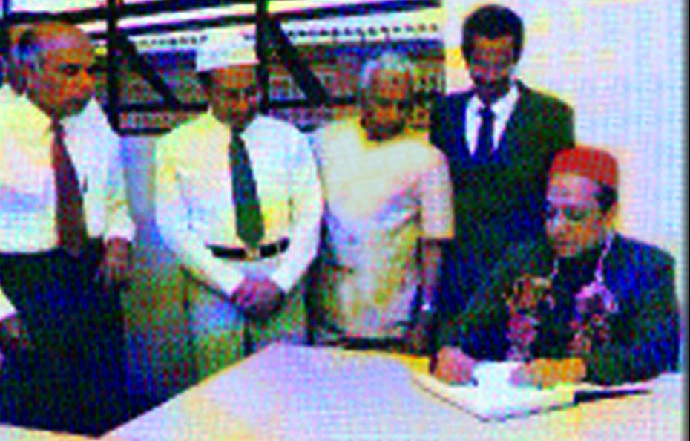
Workshops under construction
Workshops nearing completion
Workshops after completion of construction
National President Al Haj Naleem (Rah) at Inauguration of the Institute 01.01.1992

Slide 8
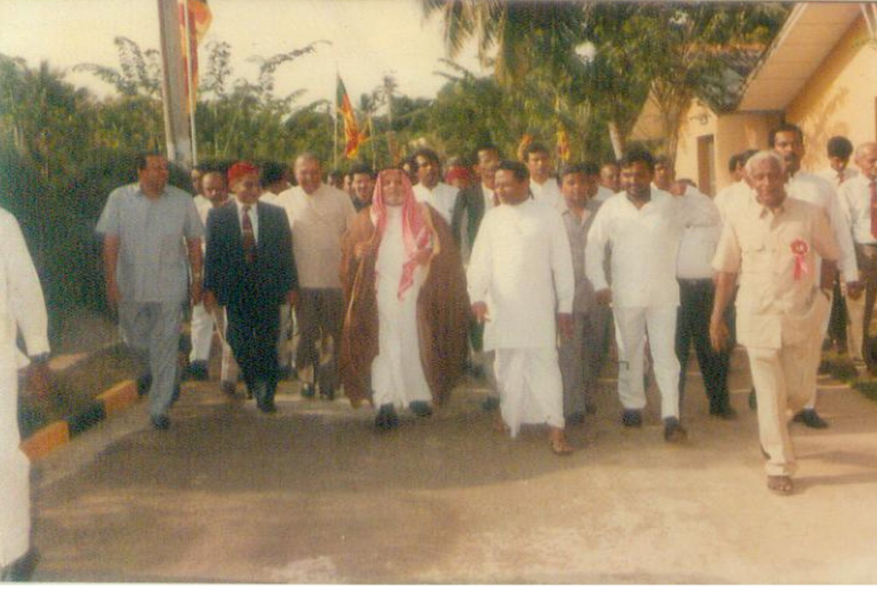
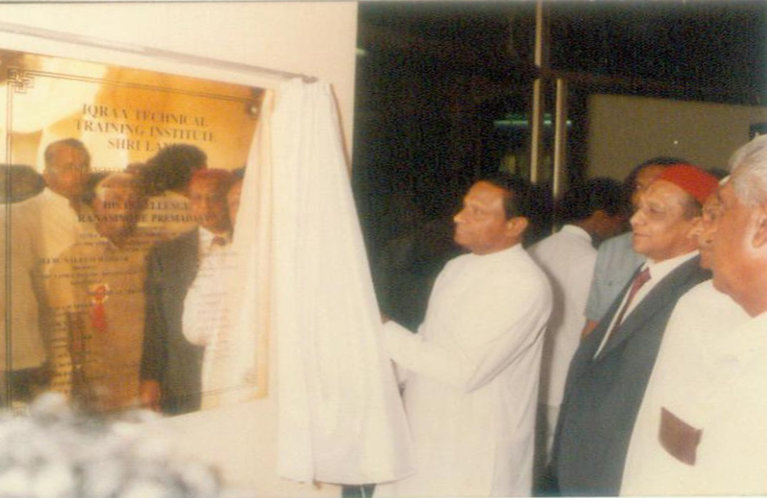
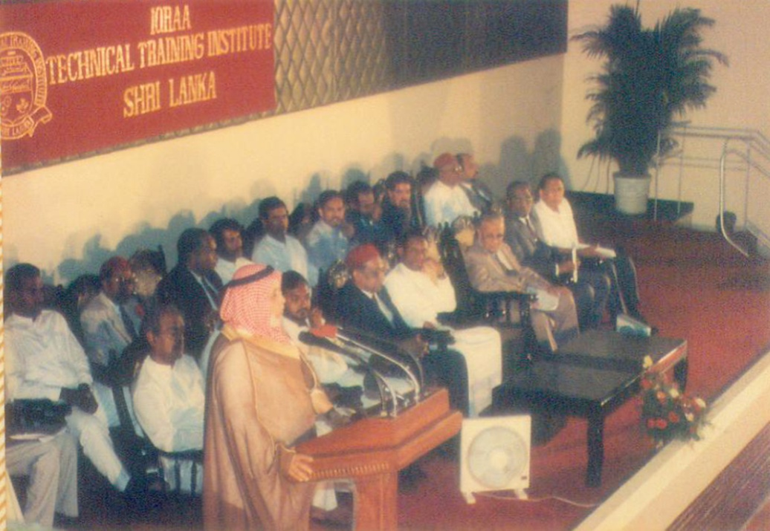
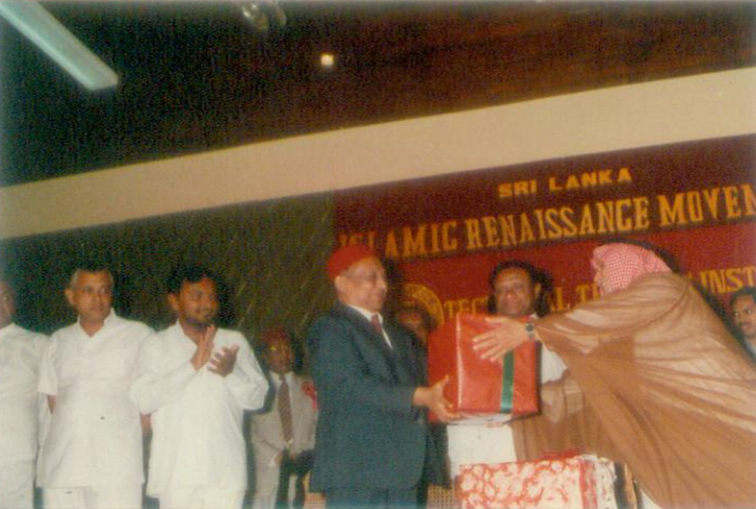
Naleem Hajiar (Rah) & Dr. Abdo Yamani (Rah) exchanging token gifts
President R.Premadasa and Dr Yamani are being conducted to the venue
H.E. the President of Sri Lanka declare opening the Institute on 18th April 1992
H.E. Dr. Abdo Yamani (Rah) addressing the gathering after the opening of the Institute

Slide 9
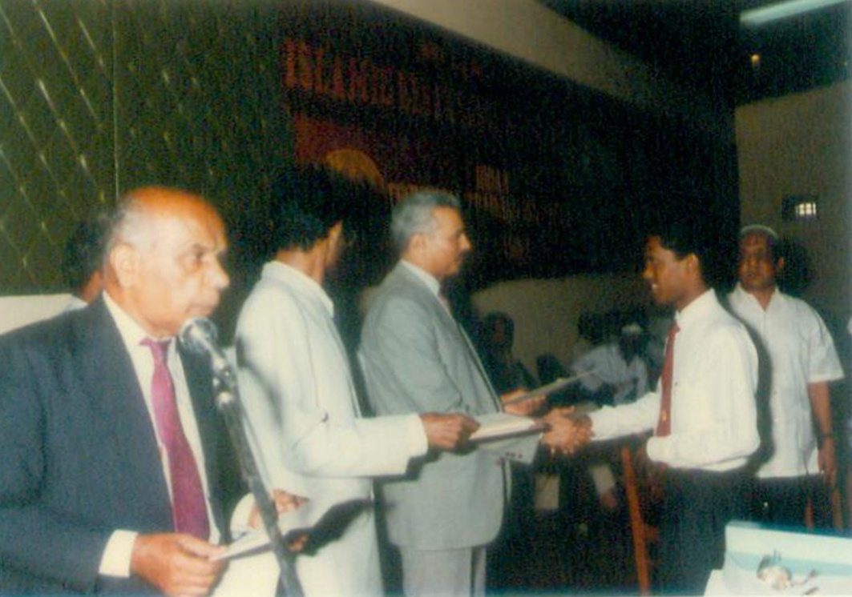
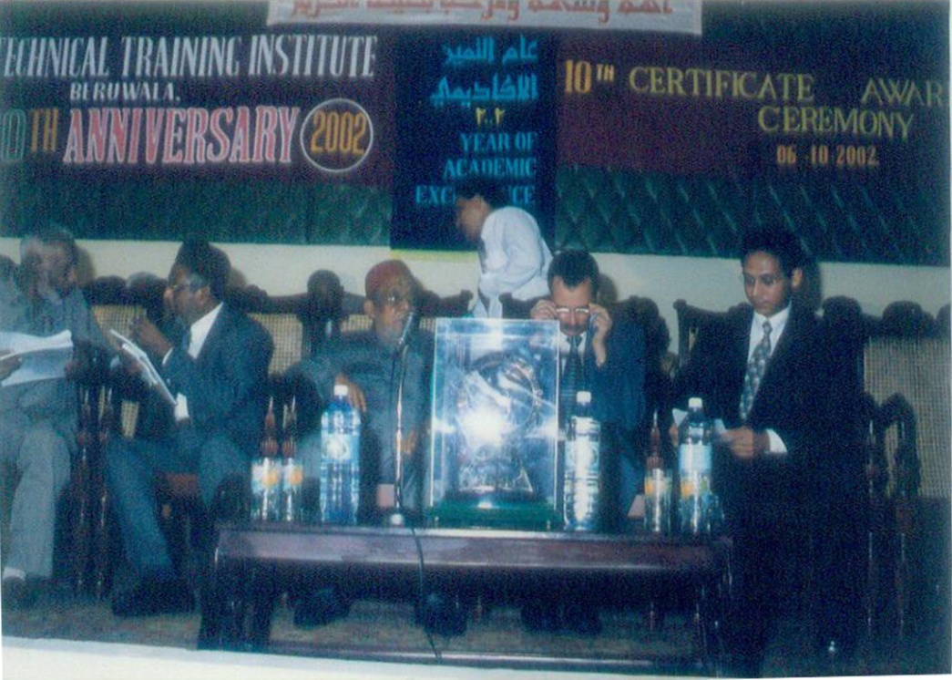
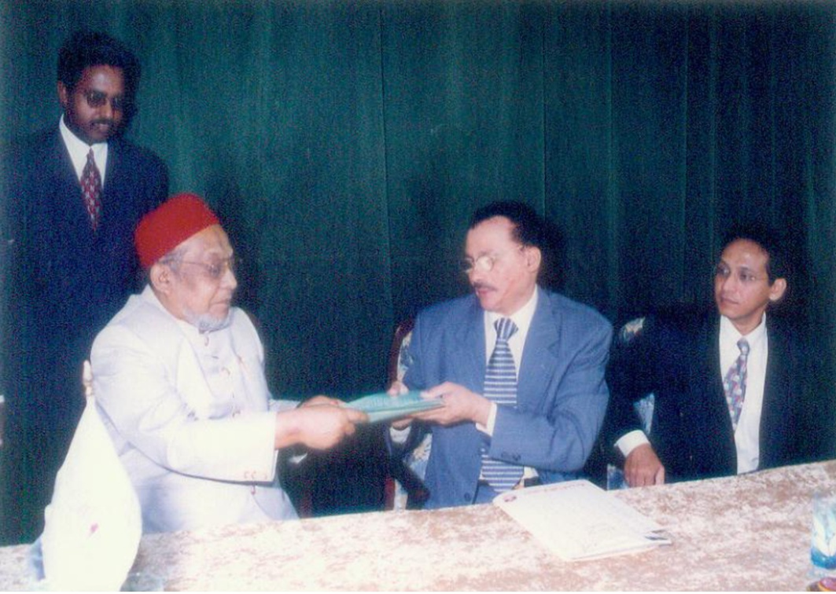
First Certificate Awarding Ceremony
10th Certificate Awarding Ceremony
Creation of the Iqraa T.T.I. Trust
Col. Zaki Azad Rahimi(Director General Iqraa), National President SLIRM Al Haj M.I.M. Naleem (Rah) and Al Haj Yakooth Naleem

Slide 10
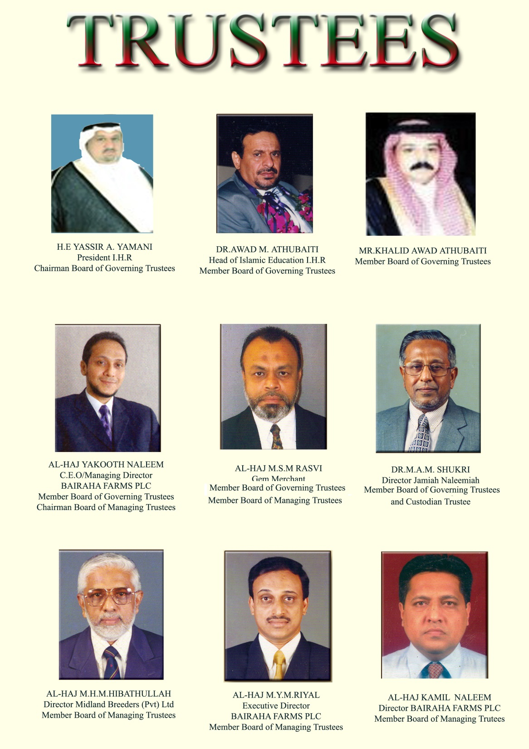

Slide 11
COURSES AND THEIR DURATION
Course | Duration
Automobile Mechanic | 2 ½ years
Refrigeration and Air-conditioning Mechanic | 2 ½ Years
Automobile Electrician | 2 ½ Years
Electrician | 2 ½ Years
Electronics Equipment Repairer | 2 ½ Years
Plumber | 1 ½ Years
Welder | 1 ½ Year
Aluminium Fabricator | 1 Year

Slide 12
Trade | Capacity for Number of Trainees
Automobile Mechanic | 40
Refrigeration and Air-conditioning Mechanic | 20
Automobile Electrician | 20
Electrician | 20
Electronics Equipment Repairer | 20
Plumber | 15
Welder | 15
Aluminium Fabricator | 20
Total | 170

Slide 13
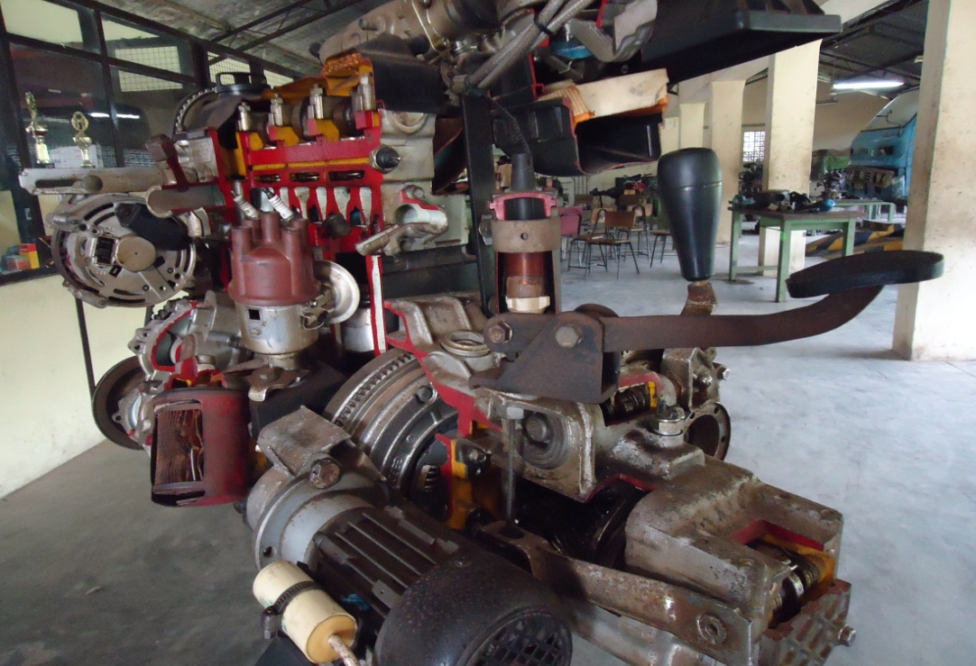
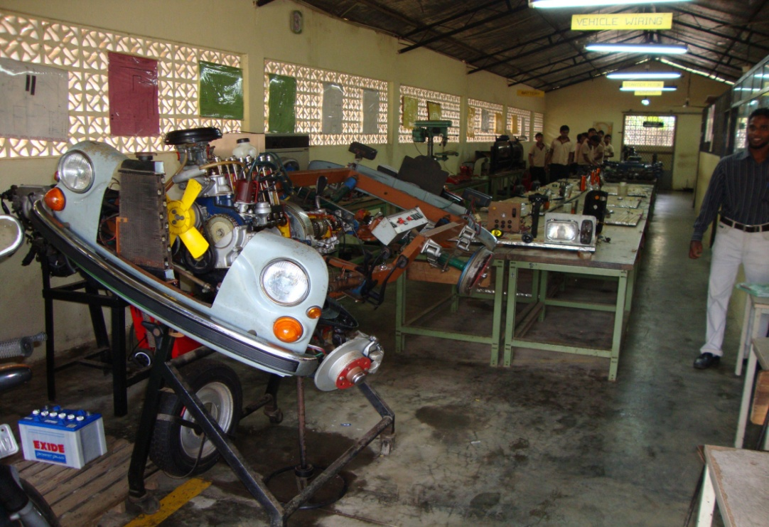
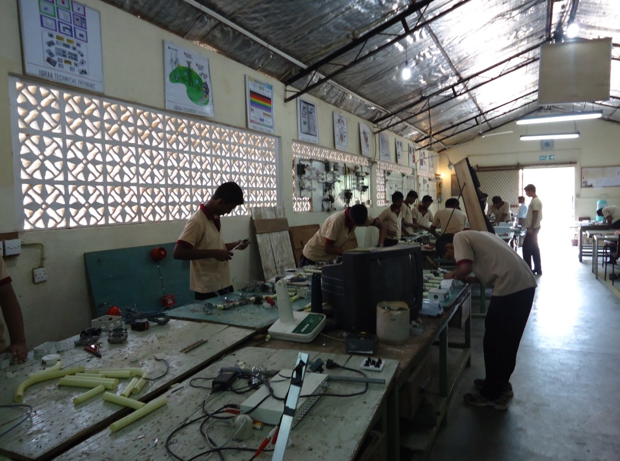
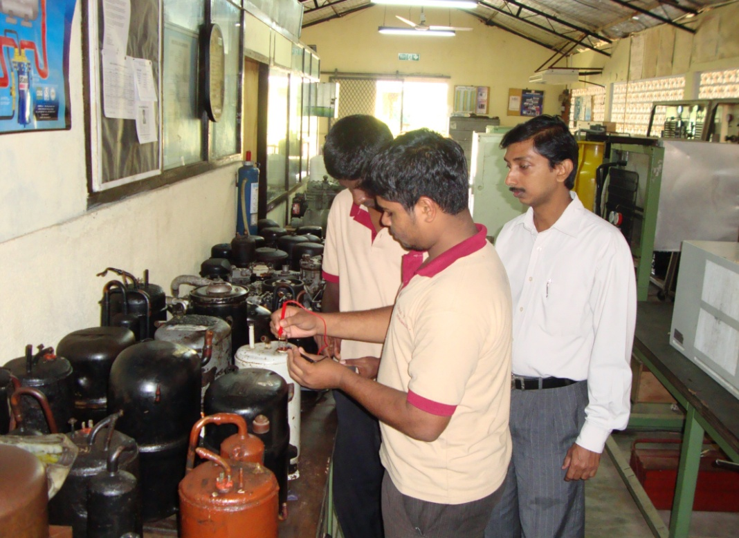
OUR WORKSHOPS
AUTOMOBILE MECHANISM
AUTOMOBILE ELECTRICAL
ELECTRICAL (POWER)
REFRIGERATION & AIR CONDITIONING

Slide 14
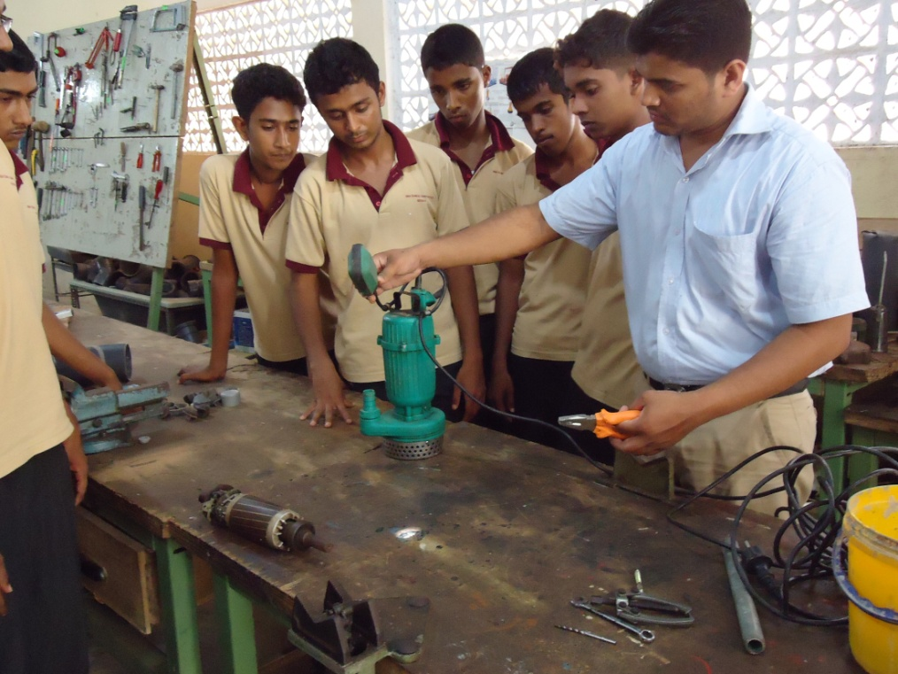
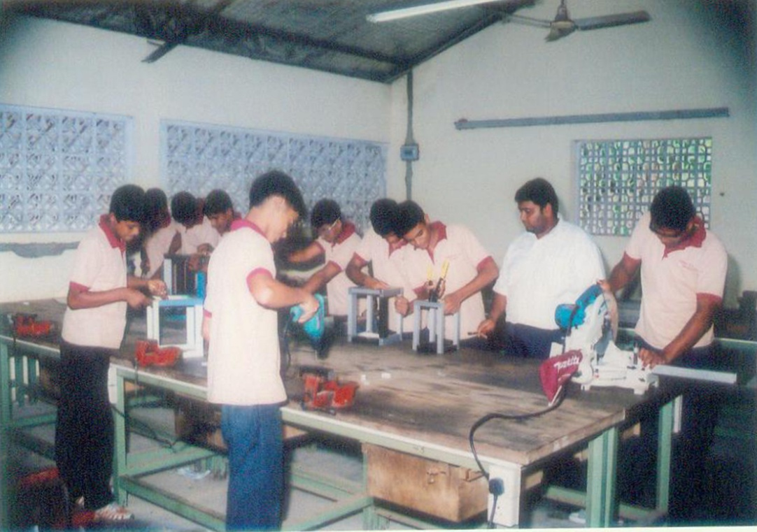
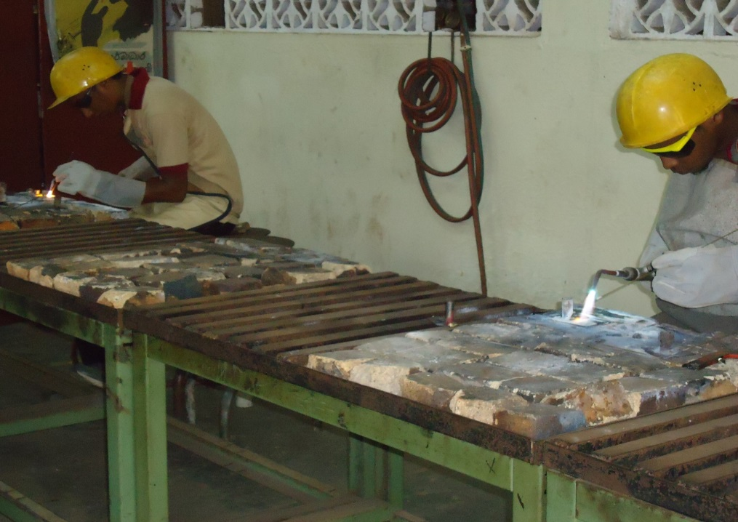
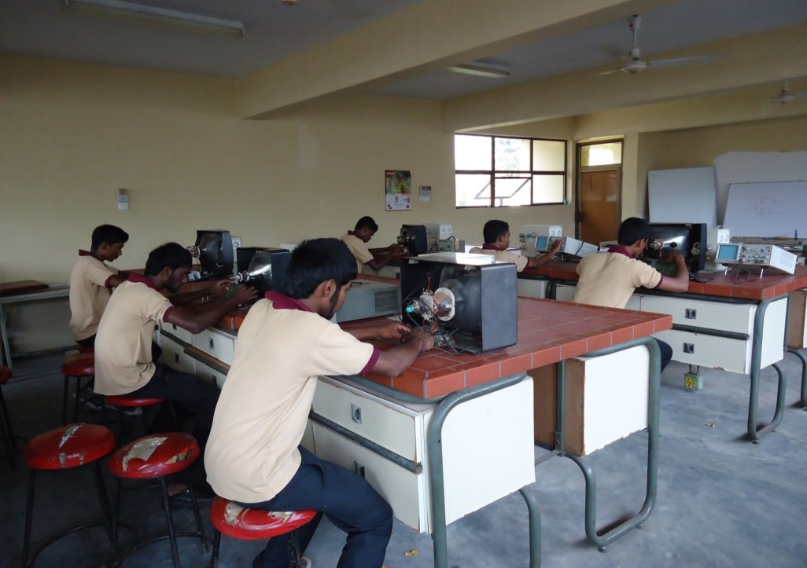
PLUMBING
ALUMINIUM FABRICATION
WELDING
ELECTRONICS

Slide 15
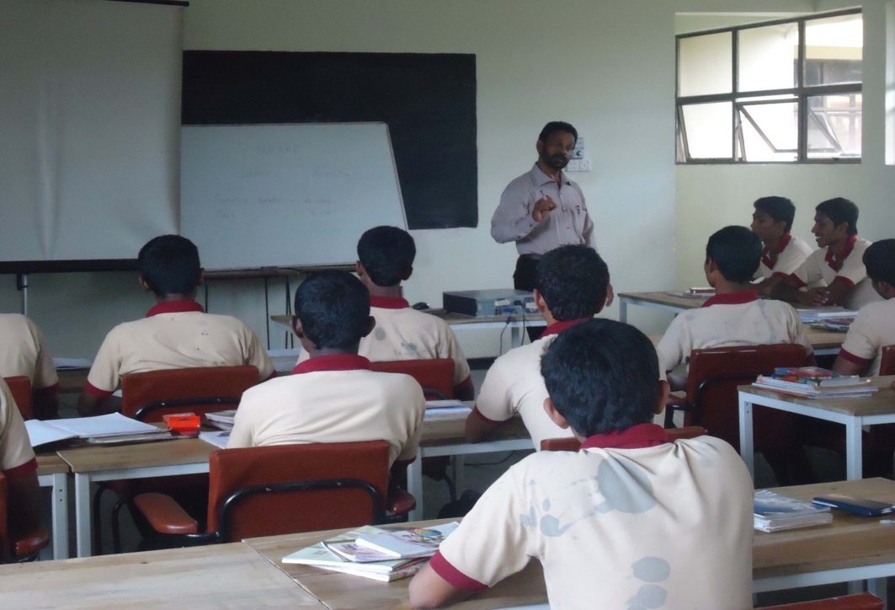
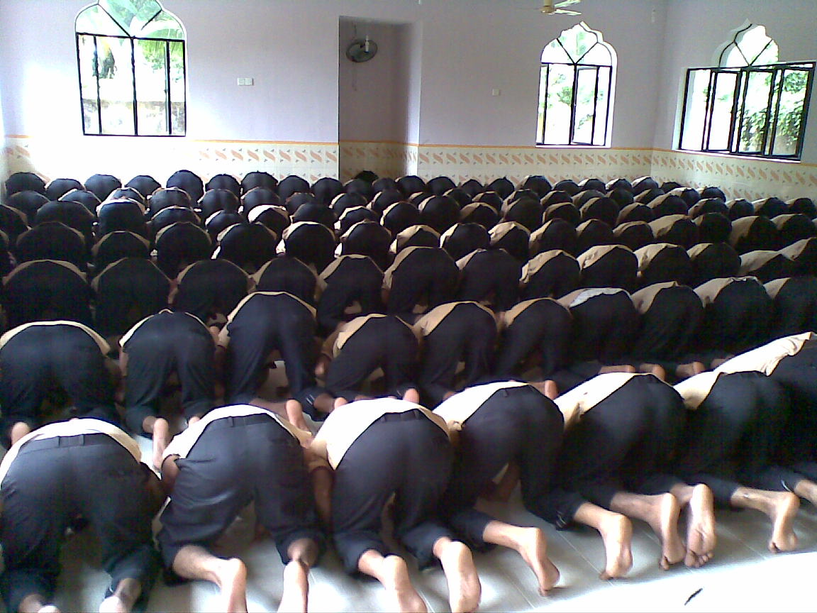
Lecture Hall
Masjid constructed by Ar-Rahmah Alalamiyyah , Kuwait

Slide 16
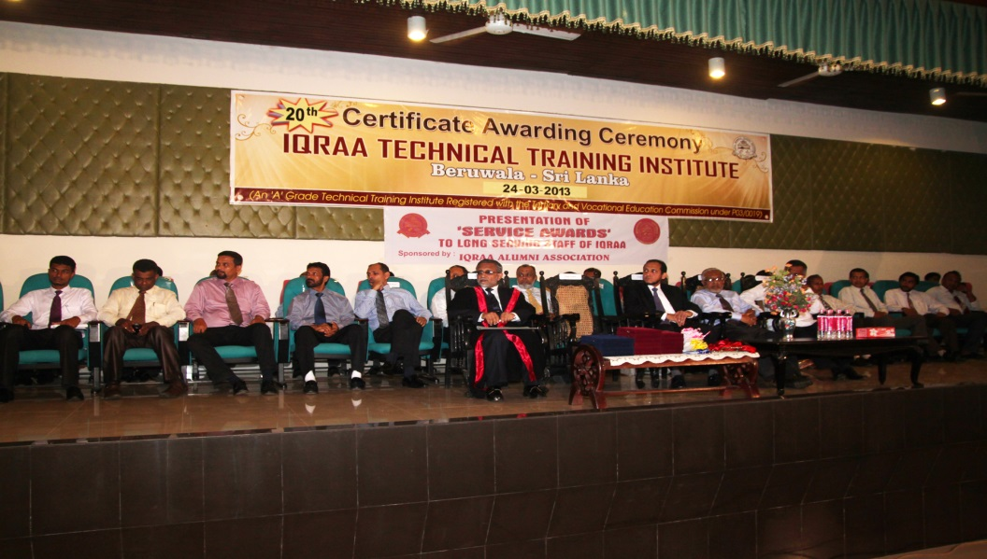
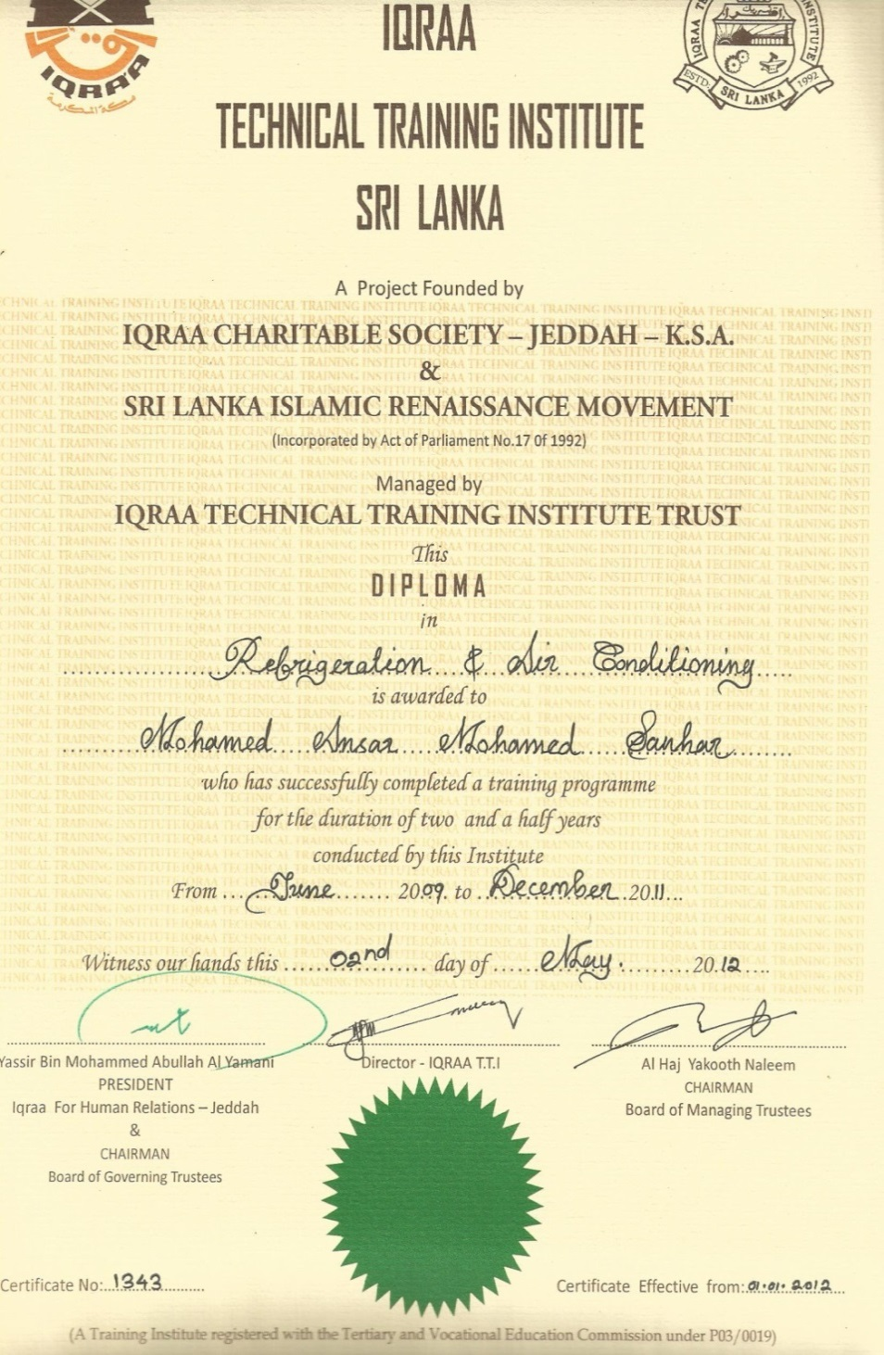
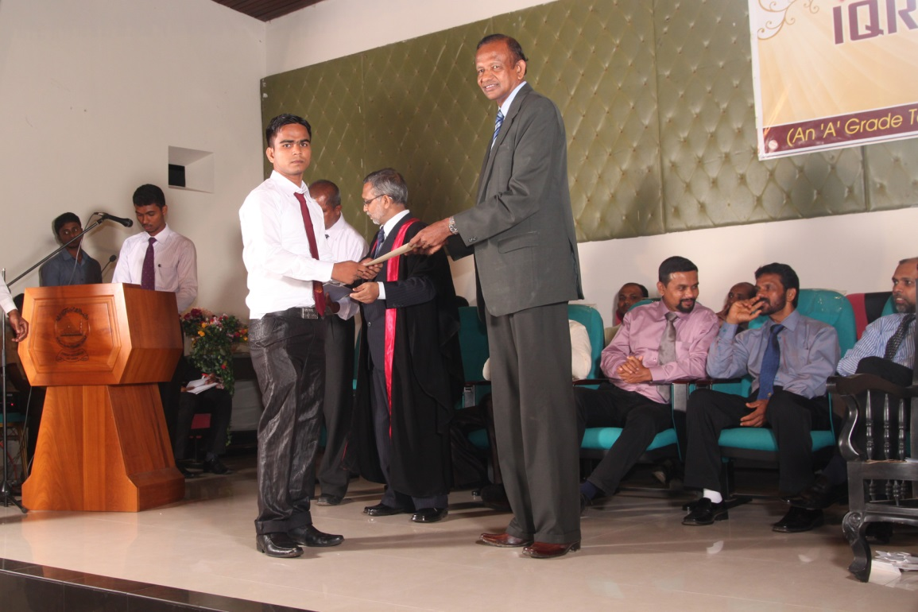
20th Certificate Awarding Ceremony

Slide 17
OUR ACHIEVEMENTS

Slide 19
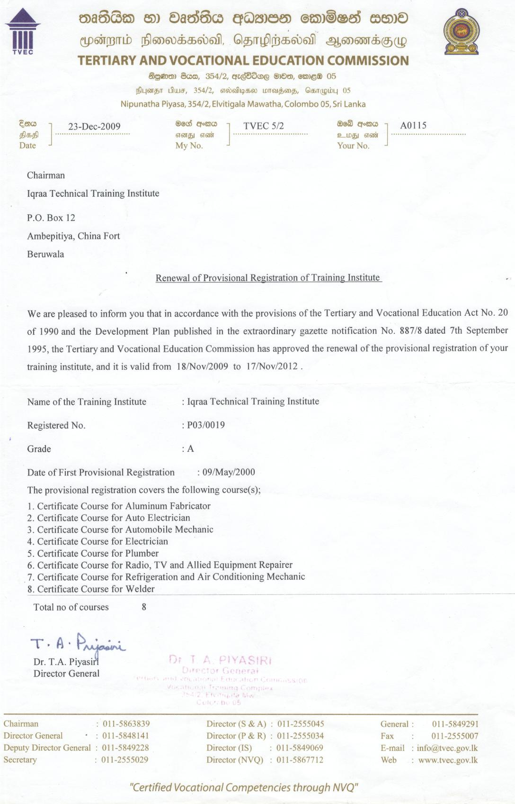

Slide 20
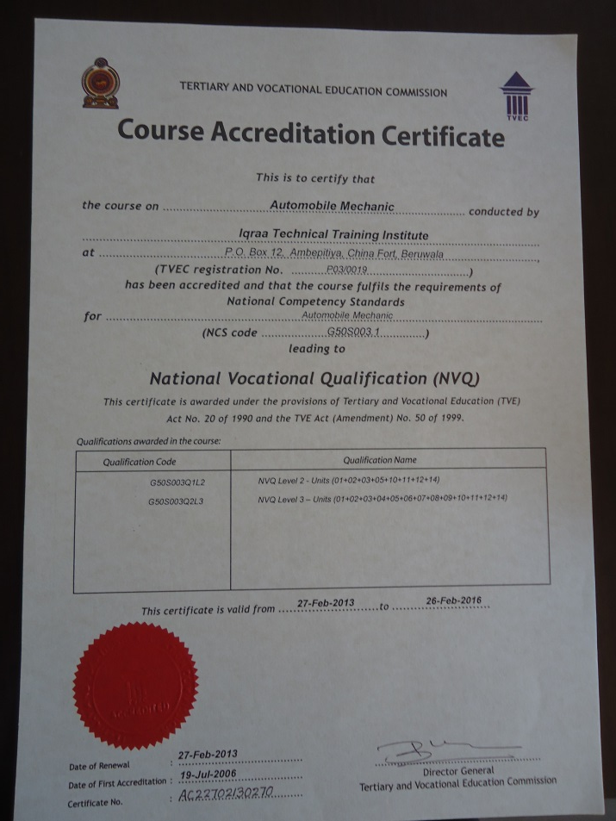
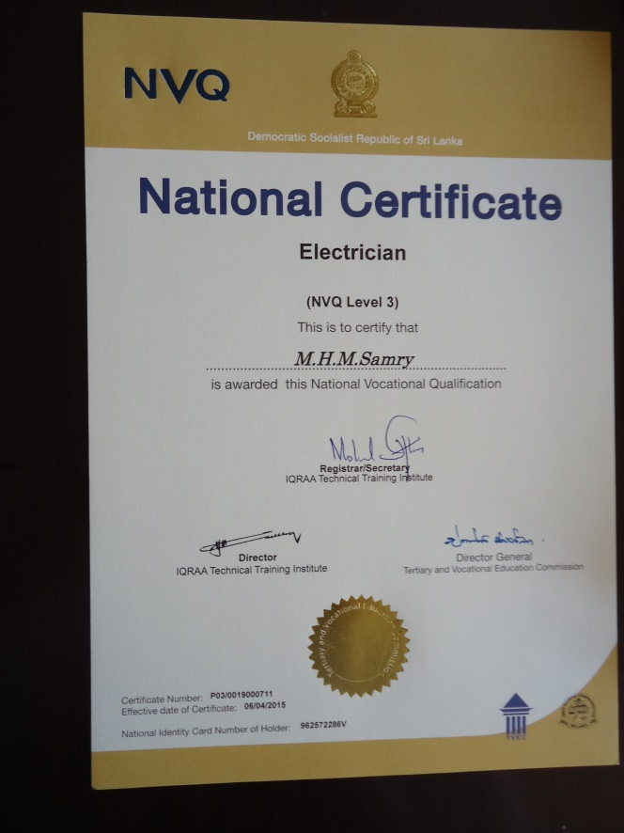

Slide 21
Ministry of Skill Development & Vocational Training
Tertiary & Vocational Education Commission
All Government & Private Technical Colleges & Vocational Training institutes
TECHNICAL & VOCATIONAL EDUCATION FRAMEWORK OF SRI LANKA

Slide 22
NVQ Level-7 ( B.Tech)
Selection Test
NVQ Level-6
NVQ Level-5
Selection Test
NVQ Level-4
NVQ Level-3
NVQ Level-2
NVQ Level-1
NVQ FRAMEWORK OF SRI LANKA

Slide 23
IQRAA TECHNICAL TRAINING INSTITUTE
has been graded as
an
‘A’ Grade Technical Training Institute
by
Tertiary & Vocational Education Commission of Sri Lanka
Under Registration No:P03/0019

